Slide 1
Job-Fit Scorer
FINAL YEAR PROJECT · B.SC. DATA SCIENCE
Automated career intelligence and ATS resume diagnostics
Rushikesh Anil Khairnar
Student ID: 5115301 · Seat No.: 52262020 · Roll No.: 21
B. K. Birla College, Kalyan
2026–27
Guide: Ms. Kajal Jaisinghani, Asst. Prof., Dept. of Computer Science
Notes:
Good morning everyone. I’m Rushikesh Khairnar, and my final year project is Job-Fit Scorer: a privacy-first career intelligence platform that shows candidates exactly how an applicant tracking system sees their resume, and how to fix it. Guided by Ms. Kajal Jaisinghani.

Slide 2
Resumes are rejected before a human reads them
THE PROBLEM
A black box
75%
Candidates get a generic rejection with no feedback on why.
Fragile parsing and strict keywords
Multi-column layouts break parsers, and exact-match filters miss “CI/CD” when the resume says “automated pipelines”.
of resumes are filtered out by an applicant tracking system (ATS)
Paywalls and privacy risk
Existing tools charge fees and store personal data on third-party servers.
Job-Fit Scorer · Project report, Ch. 1 and 3
Notes:
Industry statistics cited in the report suggest that around three quarters of resumes are rejected automatically by systems such as Workday, Taleo, Greenhouse and Lever. Candidates never learn why. Commercial checkers exist, but they are paywalled and they upload your personal data. That gap is what this project addresses.

Slide 3
Four technical goals
OBJECTIVES
01
02
Privacy-first parsing
Deterministic 10-vector ATS score
Read PDF and DOCX files inside the browser with PDF.js and Mammoth.js, so no resume leaves the device.
A rule-based rubric that gives the same score every run, with no LLM variance.
03
04
Semantic skill-gap matching
AI coaching on any device
Compare a resume with job requirements and list the missing skills a candidate should learn next.
STAR bullet rewrites, mock interviews and roadmaps, with a mobile-safe interface.
Job-Fit Scorer · Project report, §1.2
Notes:
The project was governed by four objectives: parse documents locally, score them with a deterministic rubric, match skills semantically against roles, and wrap it all in an AI coaching suite that works on mobile too.

Slide 4
Tech stack and why I picked it
TECHNOLOGY STACK
Layer | Technology | Why it was chosen
Frontend | React 19 + TypeScript | Strict types and fast rendering
Styling | Tailwind CSS v4, Motion | No runtime CSS cost
Build | Vite 6 | Instant dev server, light bundles
Parsing | PDF.js, Mammoth.js | Files are read locally, never uploaded
Charts, export | Recharts, jsPDF, docx | Radar charts and PDF or Word reports
Backend | Node.js + Express | Keeps the Gemini API key off the client
AI engine | Google Gemini (GenAI SDK) | Large context, structured JSON output
Storage | React state + localStorage | No login, no server-side data
Source: report Ch. 2 and package.json in the repository
Notes:
Every choice was compared against alternatives in Chapter 2. React and TypeScript over Angular or Vue for the type system and charts ecosystem. Tailwind over Bootstrap for zero runtime cost. Browser-side parsing over cloud OCR, which adds latency, fees and privacy risk. Node and Express so the whole project stays in one language and the API key stays on a server. Gemini for its large context window and native JSON output.

Slide 5


How the system fits together
SYSTEM ARCHITECTURE
IN THE BROWSER: NOTHING IS STORED OR UPLOADED
Resume
Ingestion
Scoring
Report
Export
PDF, DOCX or text, plus a job description
PDF.js and Mammoth, then text sanitising
10-vector ATS engine and skill matcher
Score, gaps and diagnostic cards
PDF and Word, built client-side
AI COACHING LANE: GENERATIVE TASKS ONLY
React app
Express proxy
Google Gemini
Fallback on quota errors
Sends the request to /api routes
Holds the API key, builds the prompt
Returns structured JSON
On HTTP 429 or 503 a built-in baseline answers, so the UI never breaks
Source: report Ch. 3–4 and server.ts
Notes:
Two lanes. The top lane is synchronous and entirely in the browser: parse, sanitise, score, report, export. No resume is stored or sent anywhere for scoring. The bottom lane handles generative work: the React app calls my Express proxy, which holds the Gemini key, builds the prompt and returns structured JSON. If the API is rate-limited or offline, the app serves a deterministic fallback, so the interface keeps working.

Slide 6
Seven rule-based resume checks
ATS DIAGNOSTICS ENGINE
Check | How it works
ATS fidelity | Base 50, plus contact and section points, minus table and column risk
Impact score | Bullets rated 100 (power verb), 65 (neutral) or 15 (passive), then averaged
Action verbs | 20 power verbs against 9 weak phrases, with suggested replacements
Quantification | Regex finds numbers, percentages and money; the rest get an XYZ prompt
Skill balance | Hard and soft skills counted from built-in word lists
Red flags | Clichés, old email domains, personal details and employment gaps
Readability | Flesch-Kincaid grade, hedge words and passive voice
No AI in the scoring · same resume, same result · atsEngine.ts
Notes:
This is the scoring engine in atsEngine.ts. Instead of asking an AI to guess a score, which can change from run to run, each check is a plain rule-based function. ATS fidelity starts at 50, adds up to 25 for contact details and up to 20 for standard sections, and subtracts for table or multi-column layouts. The impact score rates every bullet: 100 for a power verb, 65 for a neutral start, 15 for passive phrases like "responsible for". The other checks cover verbs, numbers, skill balance, red flags and readability. My report describes this design as ten weighted vectors; in the code it is implemented as these separate analysers.

Slide 7
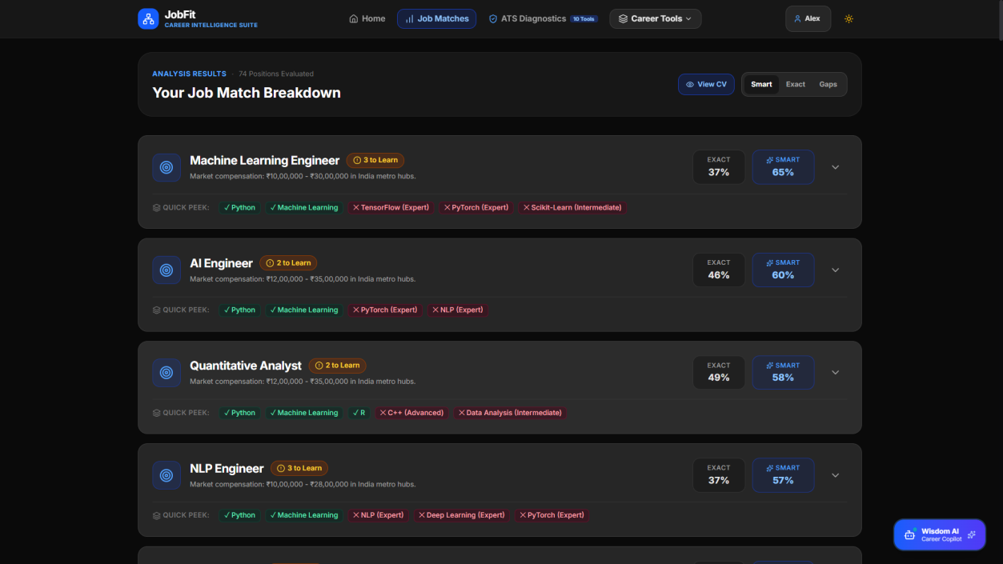
Exact and smart skill-gap scores
JOB MATCHING
Exact match
Level-weighted share of a role’s required skills found on the resume.
Smart match
Adds credit for related skills that close gaps; rule-based, not machine learning.
Gaps and radar
Each of 74 roles lists the skills to learn next, with a radar chart against an employer benchmark.
Job Match Breakdown in the deployed app
Exact: Advanced 1.0, Intermediate 0.85, other 0.6 · Smart = min(99, 0.8 × exact + 4 × related hits + 15) · App.tsx
Notes:
For a candidate’s skills, the app computes two scores against each of 74 roles. Exact is the share of required skills the candidate has, weighted by level: Advanced counts 1.0, Intermediate 0.85, anything else 0.6. Smart starts from 80 percent of that, adds 4 points for each related skill that fills a gap, adds 15 if there is any match, and caps at 99. It is a rule-based heuristic using a related-skills table, not machine learning; embedding-based matching is future work. In my test report, a React developer resume against a React job description scored 84 percent with Docker and GraphQL flagged as missing, while an IT resume against an accountant JD scored 9 percent.

Slide 8
Gemini for coaching, rules for scoring
GENERATIVE AI FEATURES
STAR bullet rewriter
Interview prep and quizzes
Turns passive duties into quantified results. In testing, “Handled server maintenance and updates” became “Automated server maintenance workflows, cutting downtime by 28%.”
Ten questions per role across technical, system design and behavioural topics, plus 10-question skill quizzes with scoring.
Live market intelligence
Wisdom career chatbot
Salary bands, demand and trending skills for a role and city, grounded with Google Search through the proxy.
A floating assistant on every screen that answers career questions through the same secure proxy.
Prompts return strict JSON schemas (report Appendix A) · server.ts · marketIntelService.ts
Notes:
Generative AI is used where it adds value: rewriting bullets, generating interview material, market research and chat. The scoring itself stays rule-based. Every prompt asks for a fixed JSON schema so the interface can render results reliably. The market explorer also falls back to a verified baseline if the backend is unreachable, for example on static hosting.

Slide 9
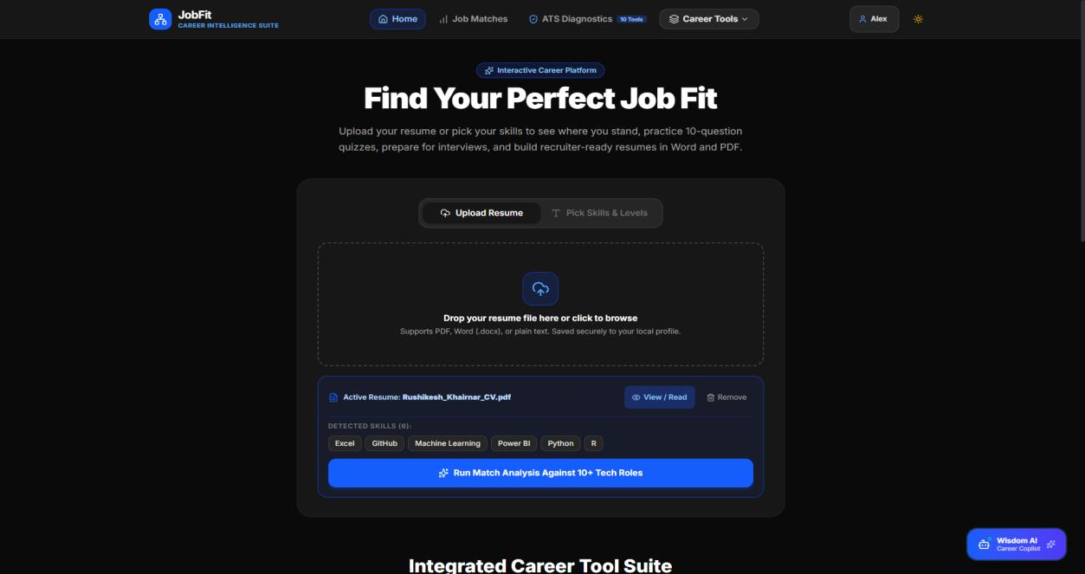
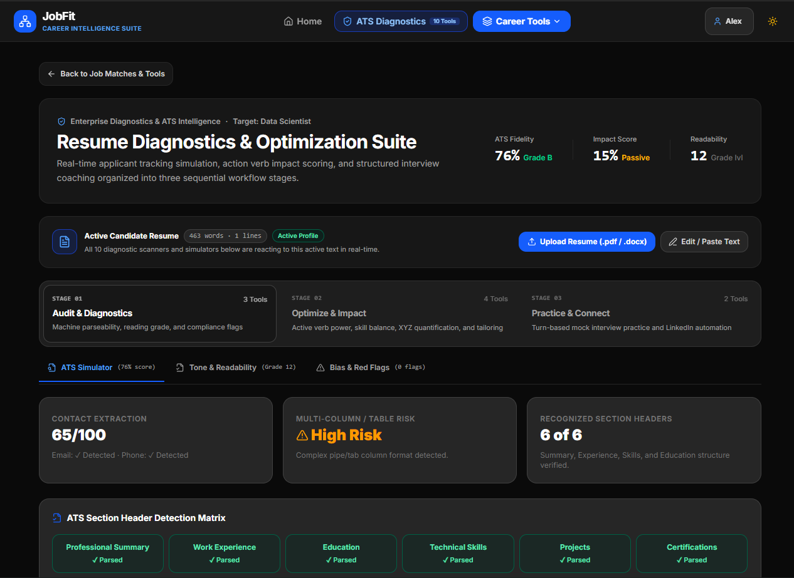
The application in use
LIVE PRODUCT
Home and resume upload
ATS diagnostics suite
Drop a PDF, DOCX or text file, and skills are detected on the spot.
Fidelity, impact and readability, with section-header detection.
Screenshots from the report, Figures 1–4 and 13
Notes:
Here is the deployed application. On the left, the home screen: upload a resume or pick skills manually, and the detected skills appear immediately. On the right, the ATS diagnostics suite, which shows ATS fidelity, impact score and readability grade, and checks which section headers a parser can recognise.

Slide 10






Your resume stays on your device
PRIVACY AND SECURITY
No server-side storage
API key shielding
Input sanitising
Parsing and scoring run in the browser, with no database of resumes.
Gemini keys sit in server environment variables, never in the client bundle.
Control bytes and malformed Unicode are stripped before tokenising.
Prompt-injection defence
XSS and headers
Checked in DevTools
User text is wrapped in schema delimiters and override commands are removed.
React escapes rendered text, and Express sets CORS and security headers.
No personal data was transmitted during local parsing and scoring.
Source: report §4.2, §4.5 and §6.1
Notes:
Privacy is the main differentiator against paid resume checkers. Documents are parsed and scored in the browser, so there is no resume database to breach. The Gemini key is only on the server. Text is sanitised, prompts are protected against injection, and React escapes output against cross-site scripting. During testing I used Chrome DevTools to confirm no personal data was sent during local parsing and scoring.

Slide 11
Every requirement met across 65+ test runs
TESTING AND RESULTS
65+
380ms
84%
40
test executions, with no crashes or divide-by-zero errors
average parse time for a complex 3-page PDF
React resume vs React JD, against 9% for an unrelated JD
beta testers: final-year students and faculty
ATS score range by resume quality (0 to 100)
Minimal resumes
12–28
Passive resumes
45–62
Well-structured
68–82
Optimised STAR resumes
85–96
Source: report §5.3, §5.5 and §6.1 (12 formal test cases, TC_01 to TC_12)
Notes:
Testing covered unit, integration and beta levels, with twelve formal test cases and over sixty-five executions. Parsing was 100 percent successful and well under the 500 millisecond target. Scoring separated resume quality cleanly: minimal resumes scored 12 to 28, optimised STAR-style resumes scored 85 to 96. Simulated Gemini quota errors were absorbed by the fallback without UI crashes, and DevTools confirmed no personal data left the browser during local scoring. Forty students and faculty members took part in beta testing.

Slide 12
Deployment with GitHub Actions
DEPLOYMENT
Push
Install
Build
Upload
Publish
Commit to the main branch
npm ci on Node 22
npm run build with Vite
The dist folder as a Pages artifact
GitHub Pages serves the site
Live demo
Codebase
rushi-khairnar.github.io/Job-Fit-Scorer
15,000+ lines of TypeScript, 19 React components and an Express proxy. On static hosting, market data falls back to a built-in baseline.
Source: .github/workflows/deploy.yml, README.md
Notes:
The project is deployed through a GitHub Actions workflow. Every push to main installs dependencies, builds with Vite, uploads the dist folder and publishes it to GitHub Pages. GitHub Pages serves static files only, so the Express proxy, which holds the Gemini key, has to run on a Node server. When the backend is unreachable, the market explorer uses a verified built-in baseline instead of failing.

Slide 13
Limitations and future work
LOOKING AHEAD
Limitations
Future scope
No built-in OCR, so scanned image-only PDFs cannot be read
Gemini calls take 1.5 to 3.5 seconds and are subject to quota limits
Scores follow industry rules, with no live link to Workday or Taleo
Speech input is unreliable on iOS Safari
Client-side OCR with Tesseract.js
Browser extension for LinkedIn, Indeed and Glassdoor
Live video mock interviews with non-verbal analysis
Hindi and Marathi resume parsing
Opt-in encrypted cloud sync across devices
Source: report §7.2 and §7.3
Notes:
Being honest about limits: the parser relies on the text layer, so scanned image PDFs need OCR. Generative calls are slower and quota-limited, which is why the fallback exists. Looking ahead, client-side OCR, a browser extension for job boards, video interviews with eye-contact and filler-word analysis, regional-language parsing and an encrypted opt-in sync are the natural next steps.

Slide 14
A transparent, private career toolkit
CONCLUSION
Transparent
Private
End to end
Replaces the ATS black box with an itemised, repeatable score and a fix list.
Resumes are parsed and scored in the browser, with no paywall and no sign-up.
Covers diagnosis, STAR rewrites, interview practice and learning roadmaps.
Thank you.
Questions?
Rushikesh Anil Khairnar
rushi-khairnar.github.io/Job-Fit-Scorer
Notes:
To conclude: Job-Fit Scorer removes the ATS black box with a transparent, repeatable score, keeps candidate data on the device, and carries the user from diagnosis through rewriting and interview practice to a learning roadmap. Thank you, and I’m happy to take questions or show a live demo.

